Slide 1
Risk Analysis and Needs and Requirements for Hazard Information
Maxx Dilley
Bureau for Crisis Prevention and Recovery

Slide 2
Historical loss data used to assess loss levels, patterns, trends and cumulative impacts on development
Historicalloss-related data used to evaluate risks of
future
losses
Future hazards
Elements at risk
People
Assets
Economic activities
Vulnerabilities
Static/dynamic
“Realized risk”
(Historical losses)
“Unrealized risk” (Probable future losses)

Slide 3
Hazard-related issues (realized)
Event characterization – in terms of magnitude, duration, location, timing and (in the case of unrealized risk), probability of occurrence
Hierarchy – primary large-scale and secondary localized hazard event identification
Attribution of losses
In real time
Hazard event historical databases
Indexing – assignment of a standarized, unique identifying number for each event

Slide 4
Hazard-related issues (unrealized)
Modelling – return periods and probabilities of future hazard event occurrence (for assessing unrealized risk)

Slide 5
Realized risk (loss and damage)
Indonesia National Agency for Disaster Management (BNPB)

Slide 6
Realized risk data: Applications
Primary data guides relief, recovery and reconstruction programmes following disasters
Input for assessing risks of future disasters
Calibrating the cost-effectiveness of investments intended to reduce losses
Tracking loss patterns and trends
Thematic analyses (e.g. gender differences in morbidity and mortality, assessing sector-specific losses)
Outcome indicators for international policy frameworks (e.g. HFA and UNFCCC CoP18 decision on loss and damage)

Slide 7
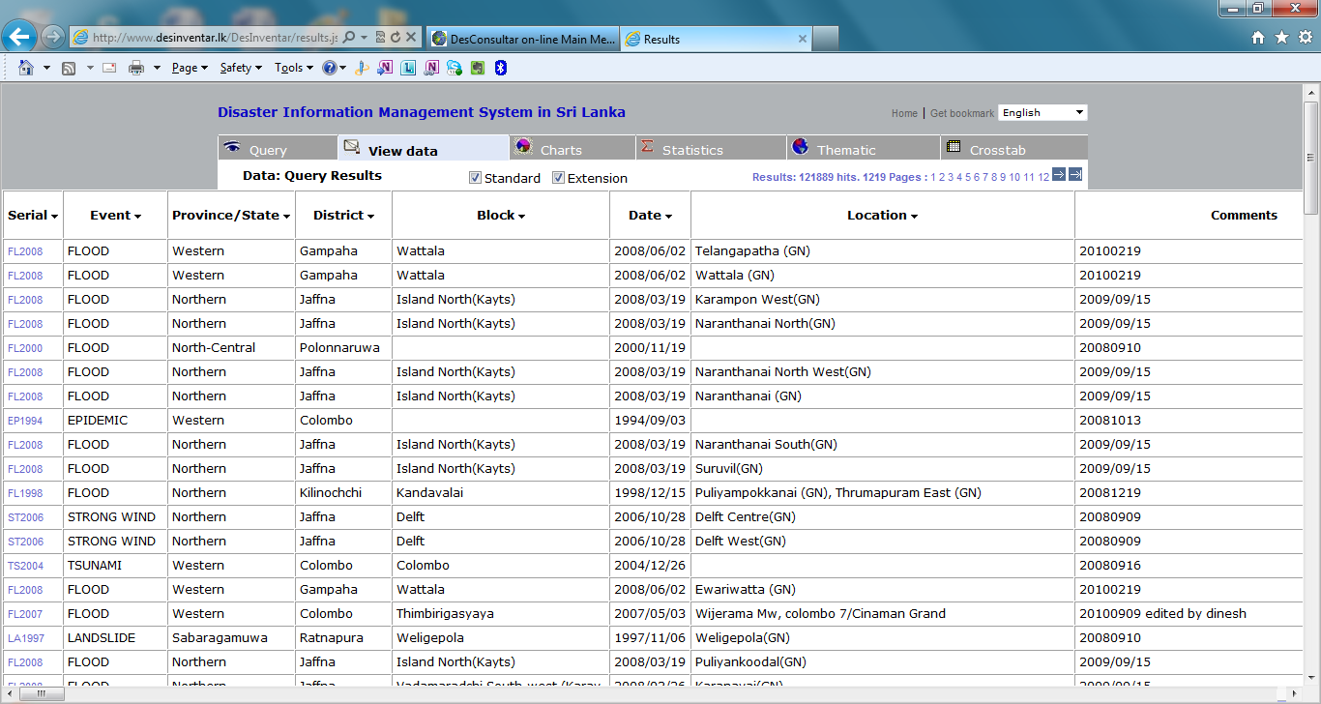

Slide 8
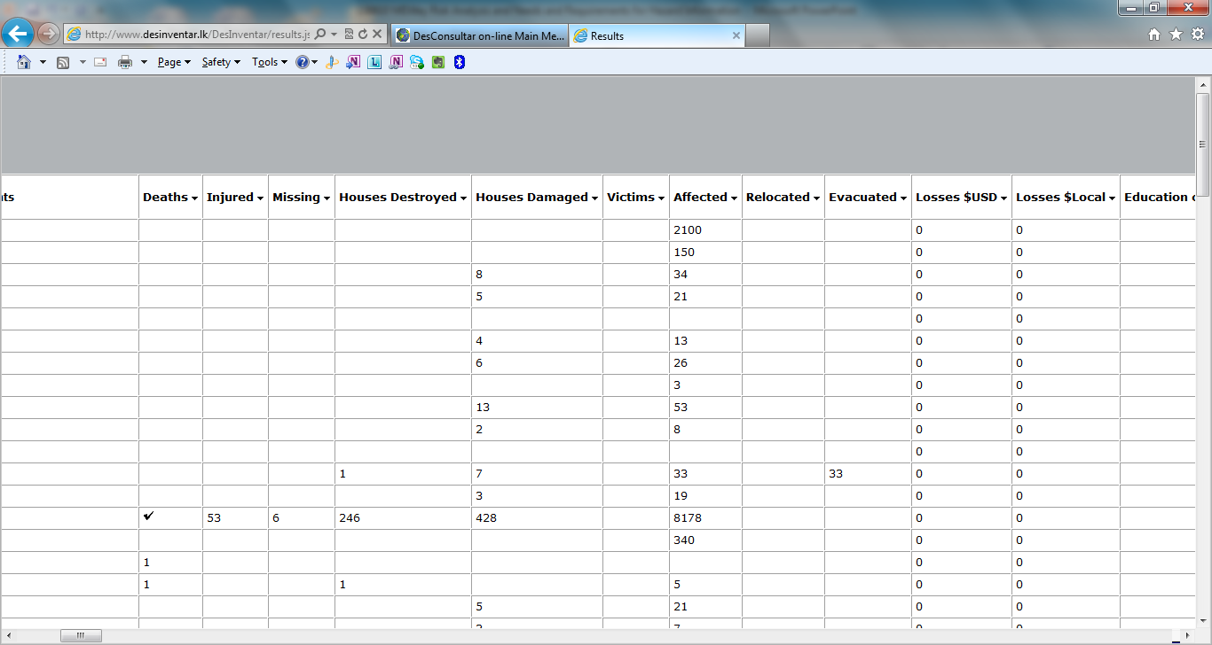

Slide 9
Country/regional level systems
57 loss and damage databases identified
50 national
4 sub-national
2 regional
1 event-based
(25 supported by UNDP)

Slide 10
System characteristics
Type of system
Language
Desinventar
Unique

Slide 11
Institutionalization
Determines:
Hosting institutions
Continuity and consistency of data reporting and recording
Quality control, credibility
Use

Slide 12
Compararison by host type
Criteria | Government-hosted | Non-government hosted
1: Up-to-date | 27 (61%) | 9 (69%)
2: Publicly accessible | 36 (82%) | 13 (100%)
3: Quality Assured | 8 (18%) | 2 (15%)
4: Applied | 13 (30%) Applications include: 8 (42%) policies 5 (26%) analysis 6 (32%) research | 8 (62%) Applications include: 3 (23%) policy 2 (15%) analysis 8 (62%) research

Slide 13
Content analysis
Currency (as of December 2012)
73% of the databases provide data through 2010
63% through 2011
28% through 2012
Completeness
the majority of databases contain blank or zero values for the key parameters of deaths and economic losses for more than 80% of their entries
the majority of databases have 30% or more entries for which all values are blank or zero
more than 50 % of the databases appear to contain data gaps (years for which no data was entered), (most prevalent in the earlier years for which the databases contain entries)

Slide 14
Content analysis
Many parameters, some with unclear definitions (“affected,” “victims”)
Inconsistent economic valuation of physical damages and losses
Lack of differentiation between zero (no losses) and missing values (no information)
Attribution of losses in localities to local secondary hazards without ability to aggregate losses associated with a larger-scale, primary hazard
Lack of application of standardizing indexing system (e.g. GLIDE)

Slide 15
Specific hazard-related needs
Standardization of hazard event identification and characterization
For real-time attribution of loss and damage (primary and secondary)
For historical analysis of hazard/loss-damage relationships
Official real-time hazard event designation and archiving of hazard event data (necessary for credibility, transparency, comparability)
Integration of hazard related standards with other standards, such as of indexing (GLIDE), core parameters, economic valuation, etc.

Slide 16
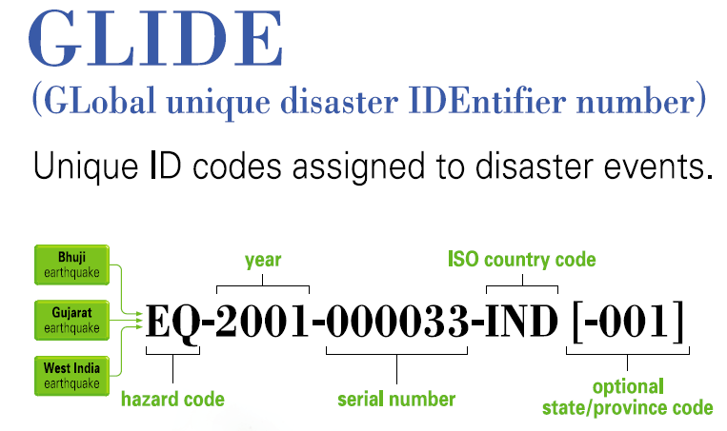

Slide 17
Unrealized risk (hazard component)
Historical hazards event occurrence is an input for anticipating future occurrence but insufficient:
Low frequency events (tsunamis, earthquakes etc.)
High magnitude events (long return periods)
Climate change (non-stationary means)
Linkage between realized and unrealized risk:
Hazard parameters associated with loss and damage (magnitude, duration, location and timing)
Modeling and forecasting of future hazard events on the basis of characteristics known to be associated with loss and damage

Slide 18
International policy context
Hyogo Framework for Action
Substantial reduction in disaster losses
MDG successor
May 30 HLP report
UNFCCC CoP 18 decision on loss and damage
“international arrangement, such as an institutional mechanism”
E.g. reporting procedure, fund, insurance, compensation

